Slide 1
iRobot
Logan Jung (Algorithm Eng.)
Nathaniel Leo (UI Eng.)
Wenbo Wang (Team Leader)

Slide 2
GOAL
Create robot (iPanda) and put it in a maze. And give a target (apple) in the maze
The robot can find the target in the maze by itself.

Slide 3
WORK LIST
UI Render
Dynamic Maze Generation
Implement Path-Searching Algorithm
Implement Path-Smoothing Algorithm
Application Coordinator

Slide 4
TECHNOLOGY
Path-Searching Algorithm: A*
Compare with:
Expanding Search
Reinforcement learning (Dynamic Programming)
Path-Smoothing Algorithm
Pygame, a popular game development library in Python
Python

Slide 5
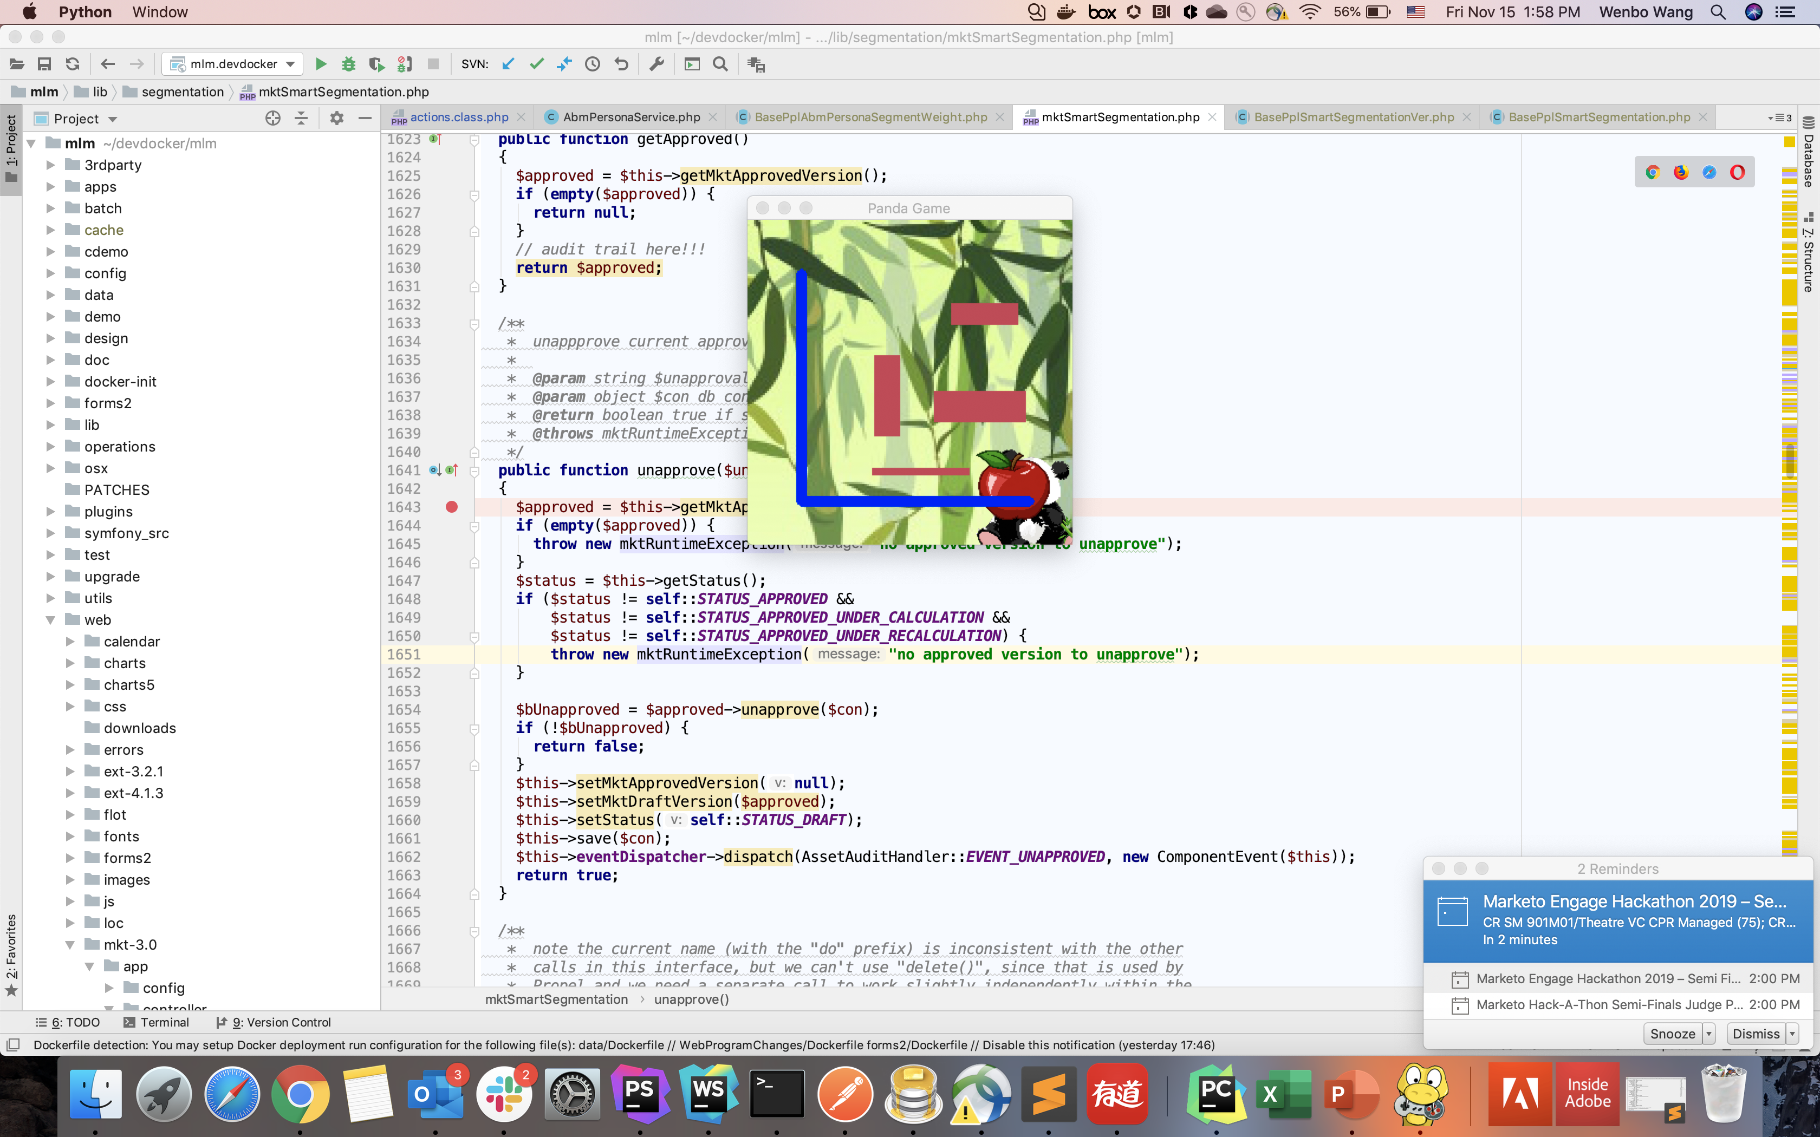
Demo

